Slide 1
Smart Attendance System

Slide 2
Abstract
IN day-to-day lives there are different types of identification system are present For the detection of Animals, students, products and also for transportation. The system like Barcode system, Smart-card and Bio-metric technology are present. As compare to them RFID is faster than barcode and smart card system and cheaper than bio-metric system, Hence we preferred to the RFID for our Project. Our project is Smart Attendance System using RFID. RFID stands for Radio Frequency Identification and Detection. In this we are using RFID reader and passive RFID chips. Reader is located on fixed location sends signal to passive RFID chip detected in range of reader. Chip re-transmits the acknowledgement signal with its unique Identifier code, hence chip is identified. Also, a single reader can identify many no of chips in very short period of time. So, we are using these properties of RFID reader and tag to monitor the student.

Slide 3
Existing system
Old fashioned student attendance system was a tedious task to perform and maintain and also time consuming.
Barcodes are less secure because can be easily reproduced.
Manual attendance system is very time consuming

Slide 4
Disadvantages
All process is done manually
Takes time
Difficult to rectify the errors

Slide 5
Proposed system
In our proposed system, we improve the student attendance system.
The Radio Frequency Identification (RFID)technology is one of an automation technology that is beneficial in improving current traditional way of monitoring.
As every tag has its own unique ID, it is easy to differentiate every tag holder.
In addition, a Graphical User Interface (GUI) provides more efficient way to review the monitor.
Thus, the integration of RFID technology and the GUI in an monitoring system will produces an automatic

Slide 6
Advantages
This system uses individual RFID tags for each user identification.
This system uses Bluetooth for communication.

Slide 7
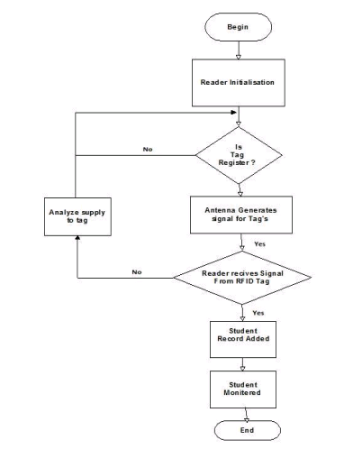
Dataflow

Slide 8
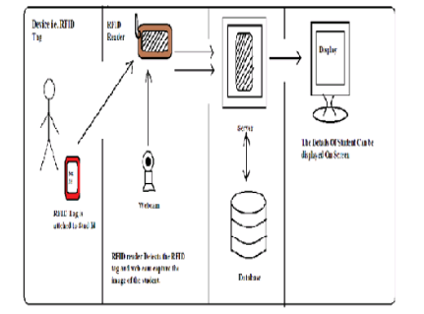
ARCHITECTURE DIAGRAM

